Slide 1
Managing Devices
Lesson 5

Slide 2
Objectives
Skill/Concept | Exam Objective | Objective Number
Understand Cloud Storage | Understand storage Understand backup and recovery methods | 5.2 6.1
Understanding Printing Devices | Understand printing devices Connect devices Understand file and print sharing | 5.3 5.1 4.2
Understanding System Devices and Device Drivers | Understand system devices Connect devices | 5.4 5.1

Slide 3
Understanding Cloud Storage
Cloud storage is remote data storage with backups but can also include application hosting.
You can use applications like Microsoft Word and Outlook, along with many other applications, over the internet.
Client machines can run applications from the cloud and access data; in fact, they can maintain complete control of their data and security.

Slide 4
Using OneDrive to Manage Files & Folders
OneDrive is a file hosting service that allows you to store and create files and folders and share them with other users and groups.
OneDrive for Business is different from the public version of OneDrive because OneDrive for Business is based on SharePoint.

Slide 5
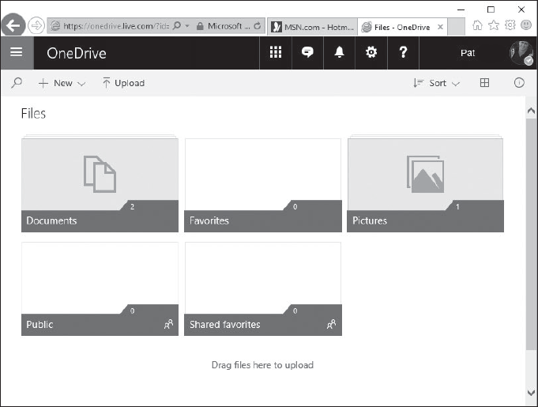
The OneDrive Console

Slide 6
Understanding Printing Devices
Printing devices can be local or networked; they can even be available over the internet.
You can perform most printer support from Devices and Printers.
A local printer is connected directly to your computer via a cable, using a serial, parallel, USB, infrared, or other port type.
A driver is a small program that enables hardware to interact with the OS.

Slide 7
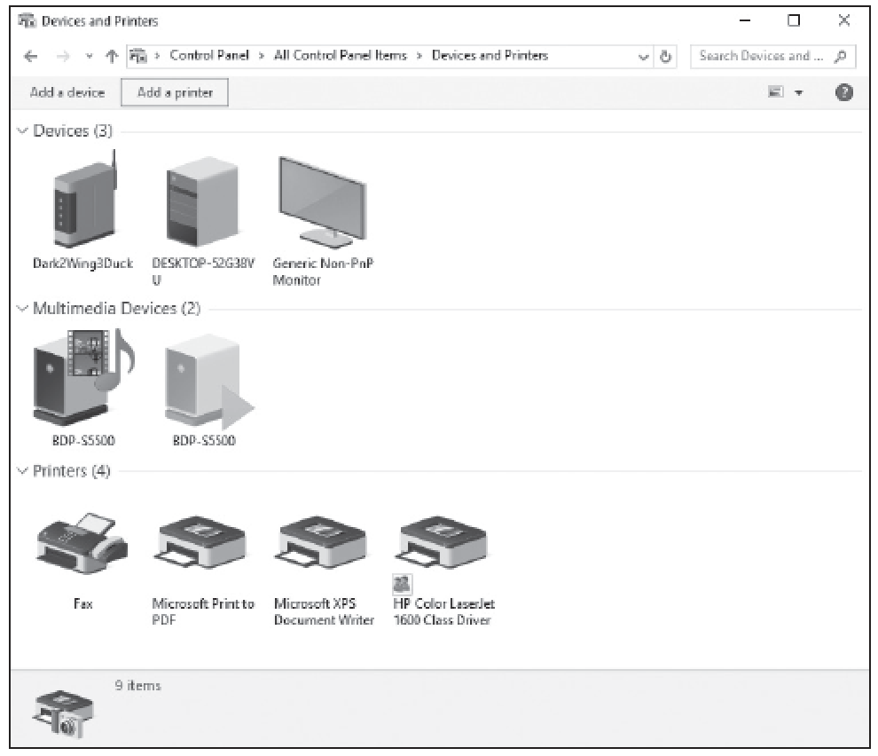
The Devices & Printers Window

Slide 8
Understanding Network Printers
A network printer generally has a network adapter and is connected to a network.
The printer receives an IP address and is a node on the network much like a networked computer.
You can share a local (directly connected) printer with others on a network; in this case, the printer is considered to be both local (to the computer to which it is connected) and networked.

Slide 9
Understanding Print Queues
The print spooler is an executable file that manages the printing process.
A print job is a file or set of files that have been sent to a printer.
A print queue is a holding area until the printer is finished printing the entire document.

Slide 10
Understanding System Devices & Device Drivers
A computer is a collection of hardware devices, each requiring a piece of software called a device driver in order to function.
Windows 10 includes a large library of device drivers.
The main video device on a computer is the video adapter or card.
The main audio device in a computer is a sound card.

Slide 11
Plug-and-Play
Nearly all modern devices that you attach to a computer port are automatically detected by the operating system. This is part of plug-and-play (PnP) technology.
As long as a PnP device is plugged into your computer and powered on (if the device requires power, like a printer), Windows detects the device and automatically installs the drivers.

Slide 12
Device Management
In most cases, the information the device driver provides is integrated into the Windows interface.
For example, the Properties dialog box for a printer includes generic system information, such as which port the printer is connected to and who is permitted to use it.
Other tabs, and particularly the Device Settings tab, are based on hardware-specific information provided by the device driver.

Slide 13
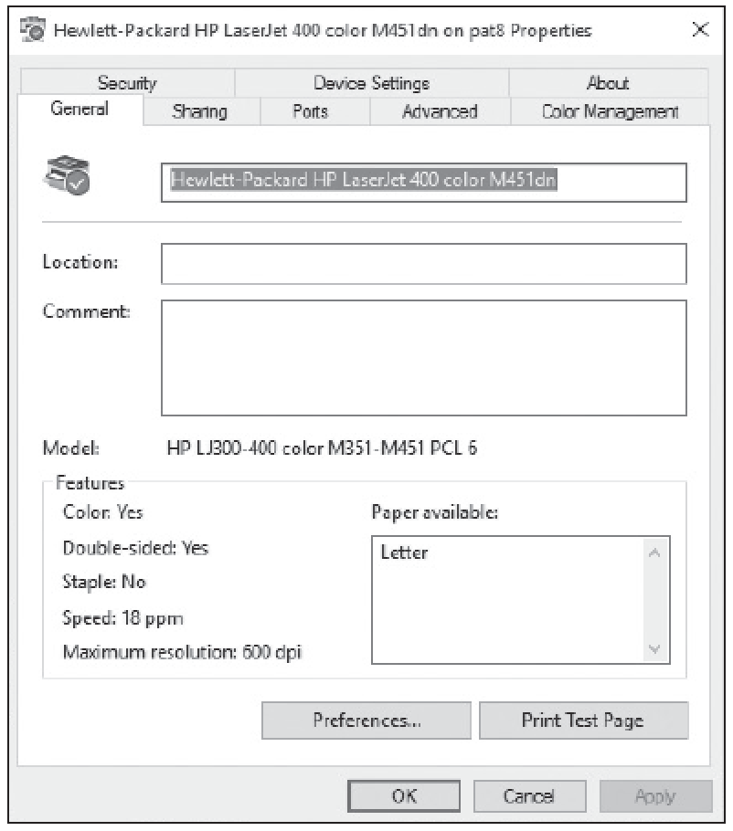
The General Tab

Slide 14
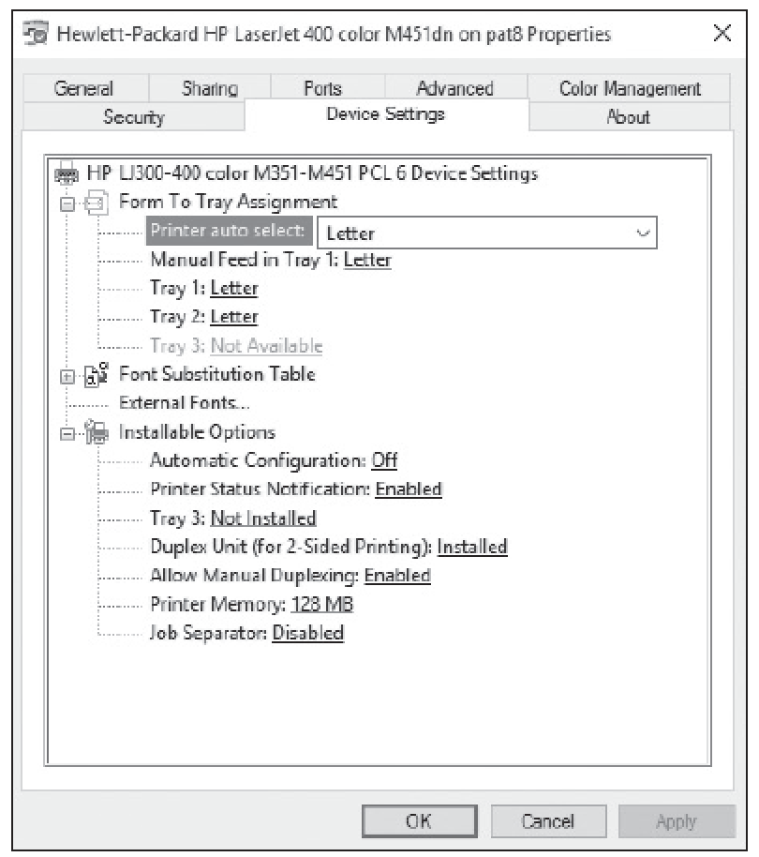
The Device Settings Tab

Slide 15
Using the Devices & Printers Folder
Windows 10 includes the Devices and Printers folder to quickly allow users to see all the devices connected to the computer and to configure and troubleshoot these devices.
It also allows you to view information about the make, model, and manufacturer and give you detailed information about the sync capabilities of a mobile phone or other mobile devices.

Slide 16
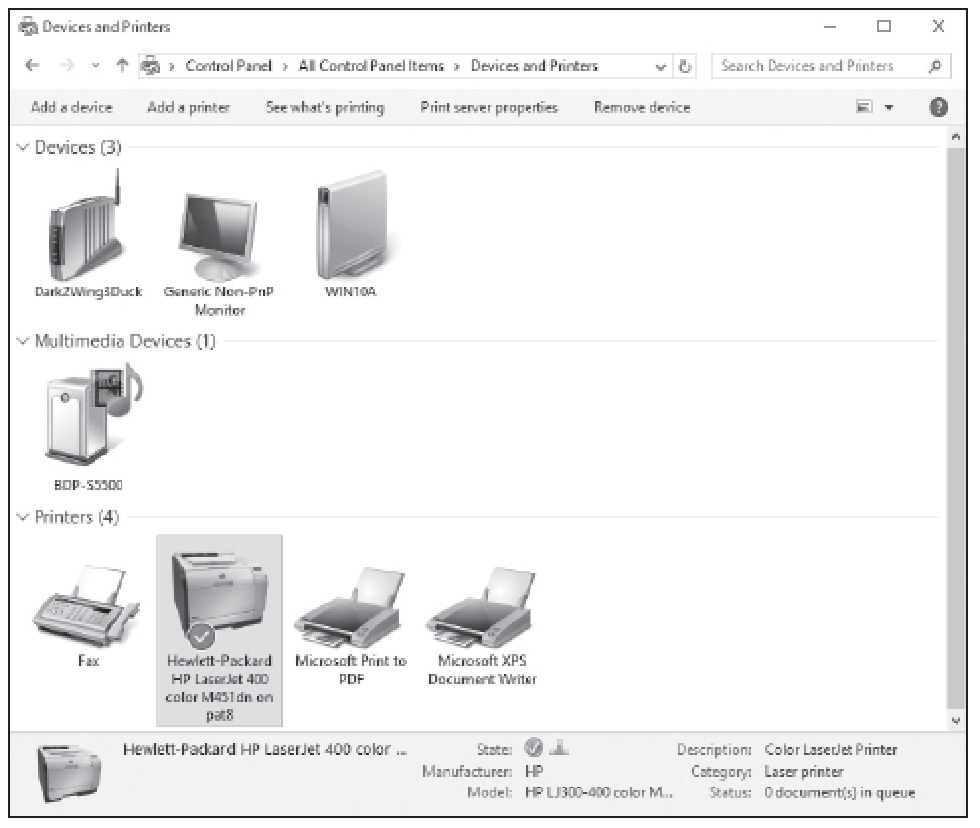
The Devices and Printers Folder

Slide 17
Using Device Manager
The Windows 10 tool for managing devices and their drivers is called Device Manager.
You can use Device Manager to get information about the devices installed in the computer, as well as install, update, and troubleshoot device drivers.

Slide 18
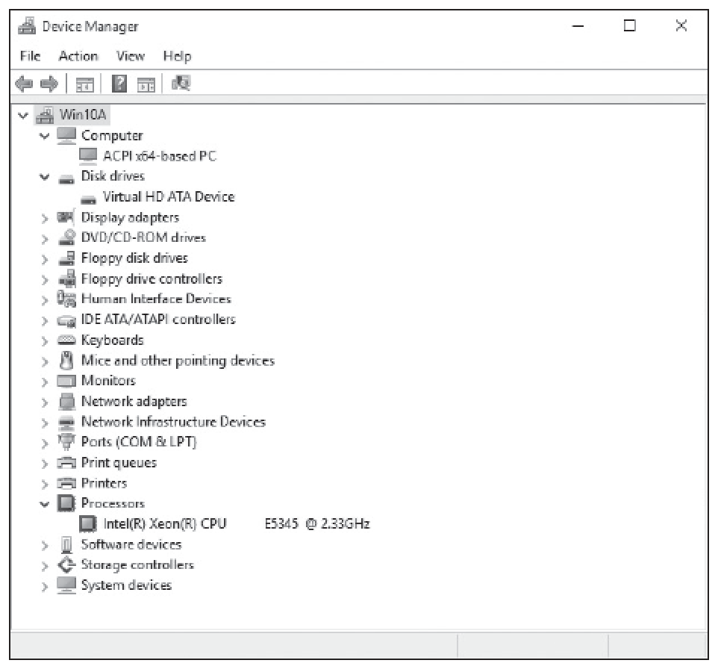
Device Manager

Slide 19
Troubleshooting Problem Devices (1/2)
The Action Center shows important notifications related to the security and maintenance of your computer.
When problems occur, you will be alerted to investigate them further.

Slide 20
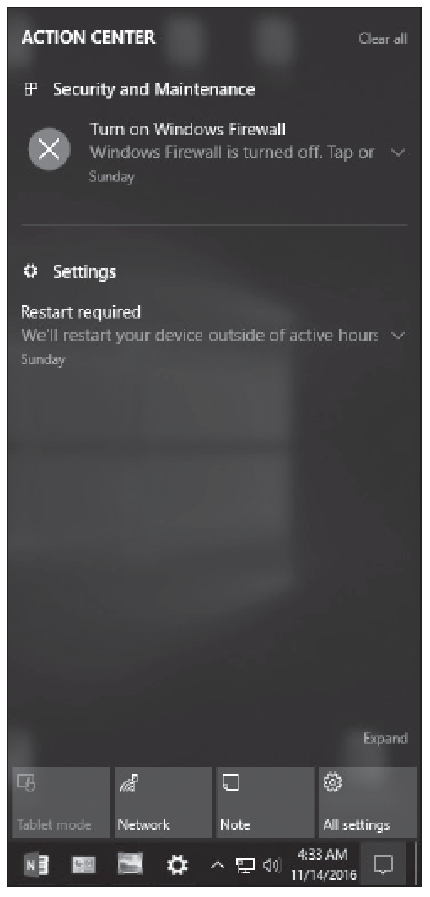
Troubleshooting Problem Devices (2/2)

Slide 21
Summary (1/5)
Cloud storage is remote data storage with backups, but can also include application hosting.
You can use applications like Microsoft Word and Outlook, along with many other applications, over the internet.
Client machines can run applications from the cloud and access data; in fact, they can maintain complete control of their data and security.
OneDrive is a file hosting service that allows you to store and create files and folders and share them with other users and groups.

Slide 22
Summary (2/5)
OneDrive for Business is different from the public version of OneDrive because OneDrive for Business is based on SharePoint.
By using SharePoint, OneDrive for Business can be used by team members to store and work on documents with others and it helps ensure that business files for your users are stored in a central location.

Slide 23
Summary (3/5)
Printing devices can be local or networked; they can even be available over the internet. You can perform most printer support from Devices and Printers.
Some printers can accept multiple pages of data at one time but larger documents can take a while to print. You can think of a print queue as a holding area until the printer is finished printing the entire document.

Slide 24
Summary (4/5)
A computer is a collection of hardware devices, each of which requires a piece of software called a device driver in order to function.
Windows 10 includes a large library of device drivers, but it is still sometimes necessary to obtain them directly from the vendor.
Windows 10 includes the Devices and Printers folder to quickly allow users to see all the devices connected to the computer and to configure and troubleshoot these devices.

Slide 25
Summary (5/5)
It will also allow you to view information about the make, model, and manufacturer and give you detailed information about the sync capabilities of a mobile phone or other mobile devices.
The Windows 10 tool for managing devices and their drivers is called Device Manager.
You can use Device Manager to get information about the devices installed in the computer, as well as install, update, and troubleshoot device drivers.

